Slide 1
Welcome to English E32101 Online Learning

Slide 2
It’s a must.
1. Gadgets: - Notebook or desktop or tablet or Ipad 2. Applications - Facebook, Quizziz, Socrative, Google Classroom, Google Form

Slide 3
Entertainments

Slide 4
Objectives: 1. Students are able to pronounce and define words correctly. 2. Students are able to answer questions correctly after reading and listening about the entertainments.

Slide 5
Types of Entertainments

Slide 6
Types of Entertainments
See movies

Slide 7
Types of Movies
Action: a movie with a fast-moving plot, usually containing scenes of violence or fighting

Slide 8
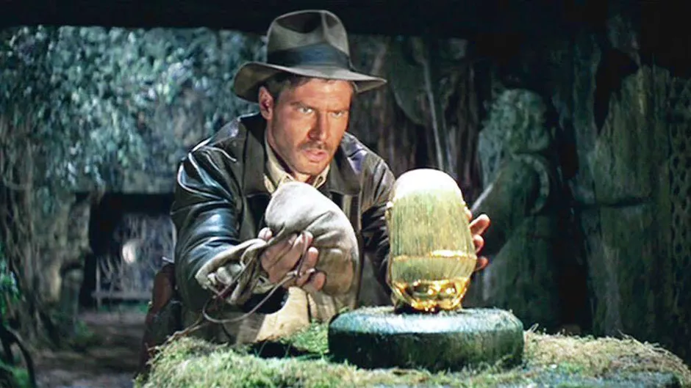
Types of Movies
Adventure: a movie about an exciting, and dangerous activity, such as a trip or experience

Slide 9
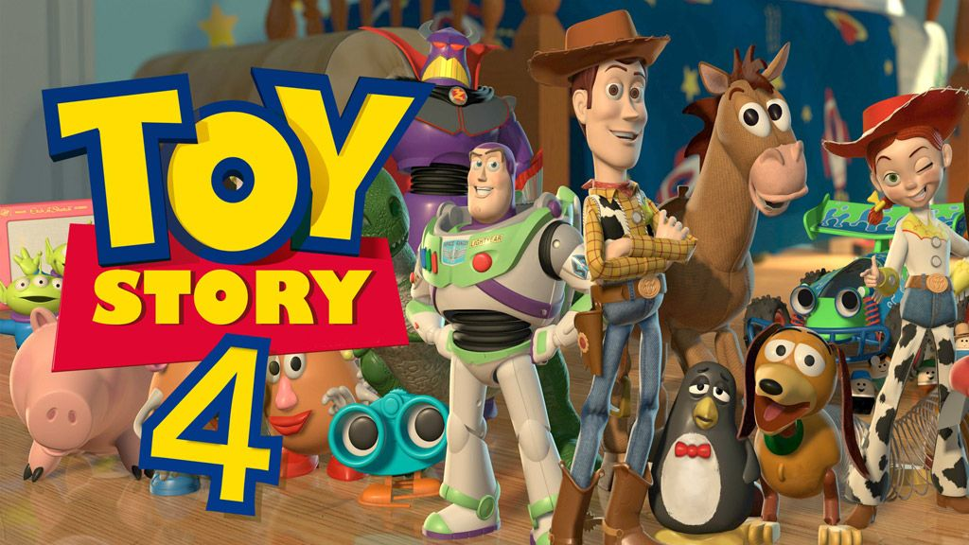
Types of Movies
Animation: a film made by photographing a series of cartoon drawings to give the illusion of movement

Slide 10
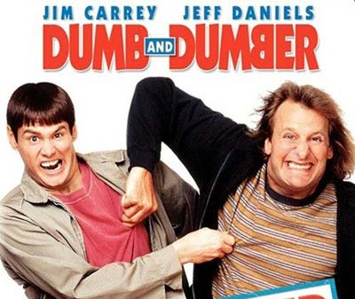
Types of Movies
Comedy: a movie that is intended to entertain people and make them laugh

Slide 11
Types of Movies
Crime: a movie that is about the persons who do something against the law. It’s an unlawful act punishable by the state.

Slide 12
Types of Movies
Documentary: a film or television or radio program that gives facts and information about a subject

Slide 13
Types of Movies
Drama: A film that shows us human beings at their best, their worst, and everything in-between.

Slide 14
Types of Movies
Erotic: An unsuitable film for children to see because it’s about the sexual feelings.

Slide 15
Types of Movies
Fantasy: Movies include magical and impossible things that any real human being cannot do.

Slide 16
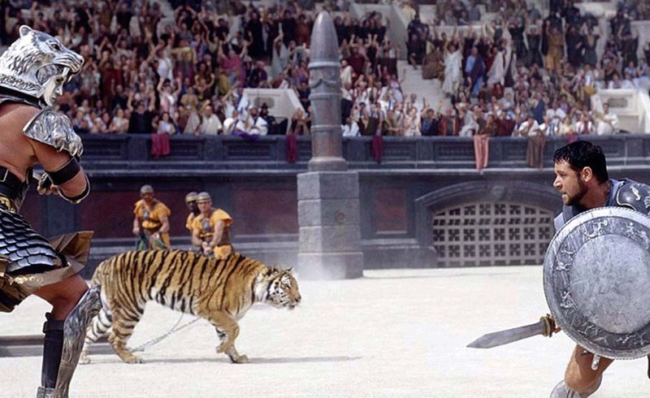
Types of Movies
Historical: A film that shows us about the past events or set within a in a past time period.

Slide 17
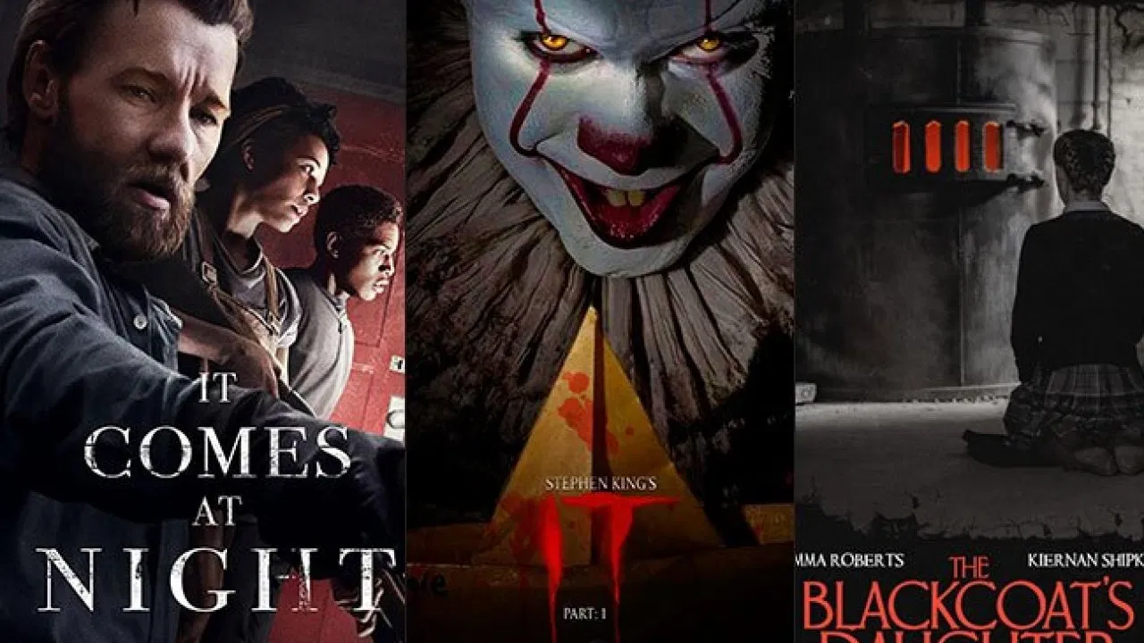
Types of Movies
Horror: a movie in which strange and frightening things happen

Slide 18
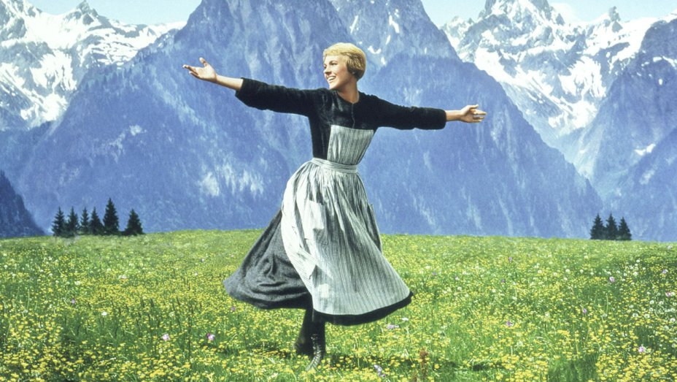
Types of Movies
Musical: a film that uses song and dance to add to the telling of the story.

Slide 19
Types of Movies
Mystery: a film that centers around a crime, usually murder, which finally gets solved at the very end.

Slide 20
Types of Movies
Romance: films that are about love stories, or affairs of the heart and the journey that their love takes through courtship or marriage

Slide 21
Types of Movies
Science fiction, Sci-fi: a kind of story in which imaginary future developments in science and their effect on life are described

Slide 22
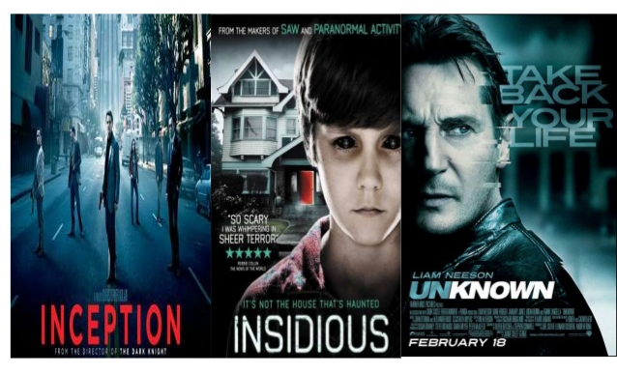
Types of Movies
Thriller: a film that has en exciting story, often about solving a crime.

Slide 23
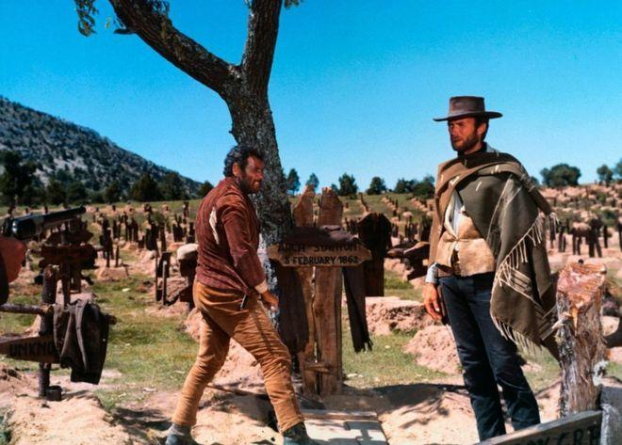
Types of Movies
Western: a film about life in the 19th century in the American West also cowboy film which is often about fighting between cowboys and Indians.

Slide 24
Types of Music
Rhythm and Blues

Slide 25
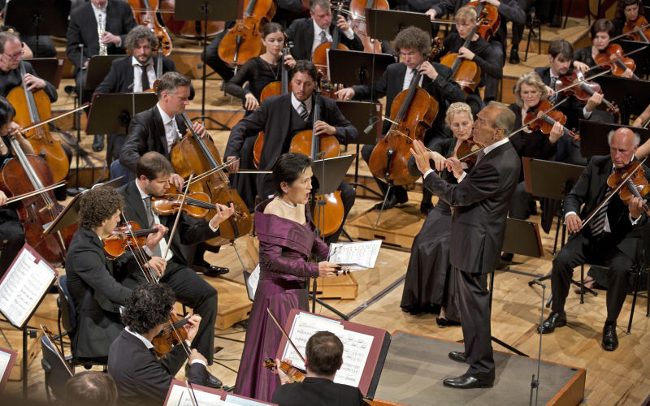
Types of Music
Classical

Slide 26
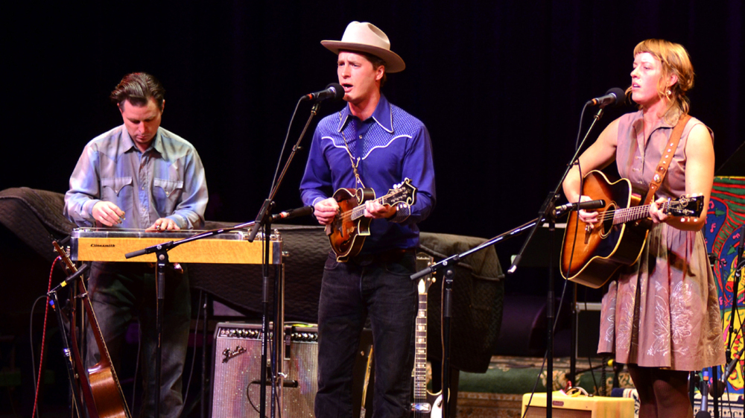
Types of Music
Country

Slide 27
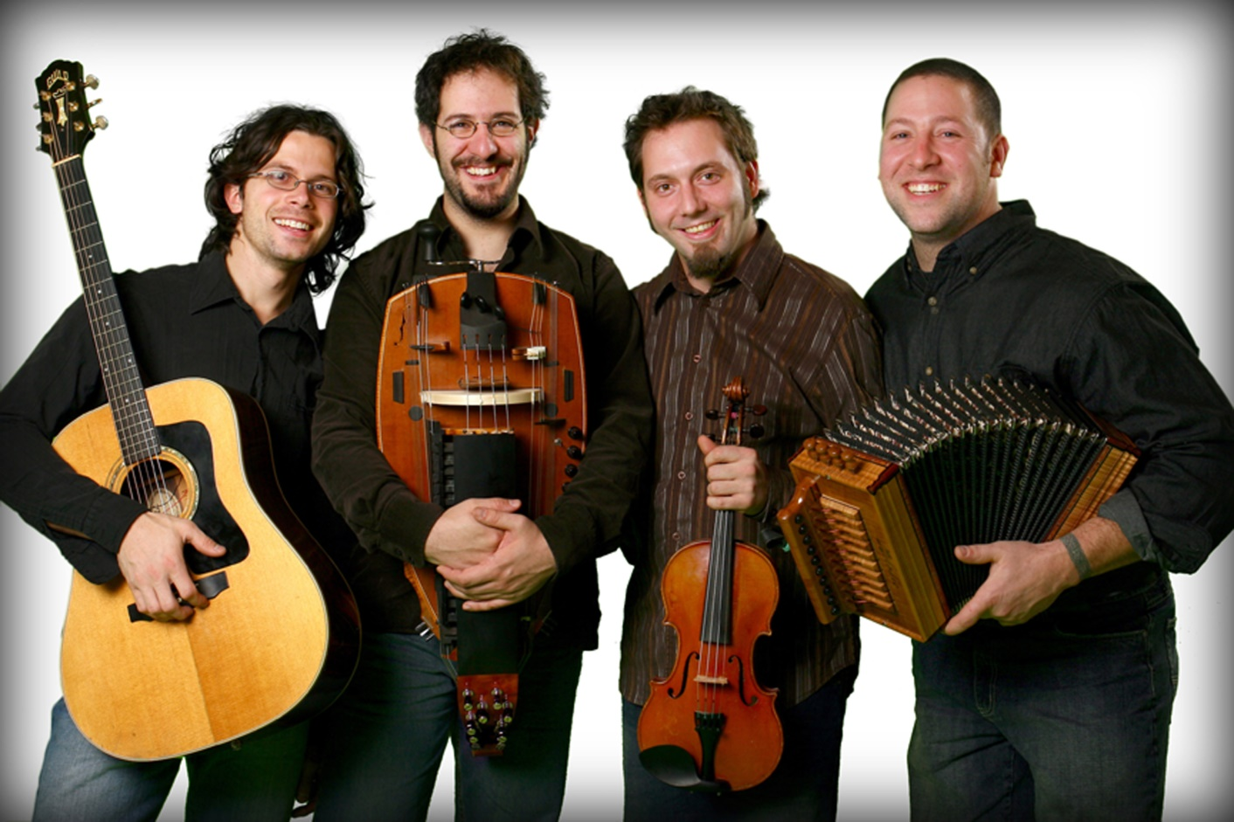
Types of Music
Folk

Slide 28
Types of Music
Hip-Hop

Slide 29
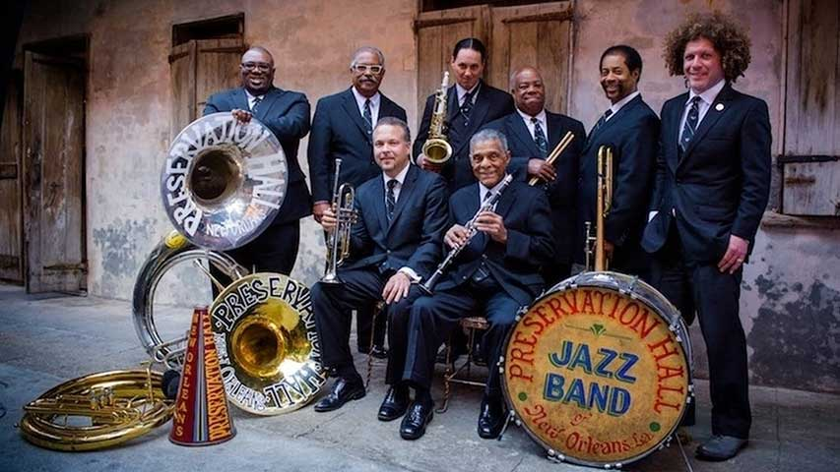
Types of Music
Jazz

Slide 30
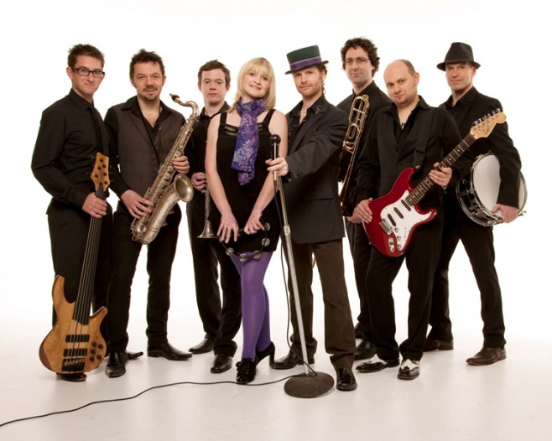
Types of Music
Pop

Slide 31
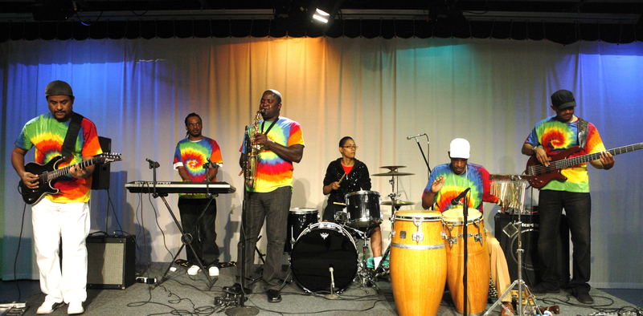
Types of Music
Reggae

Slide 32
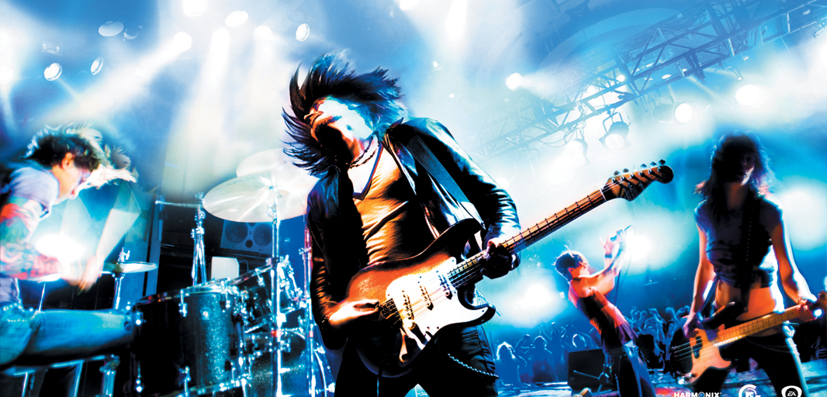
Types of Music
Rock

Slide 33
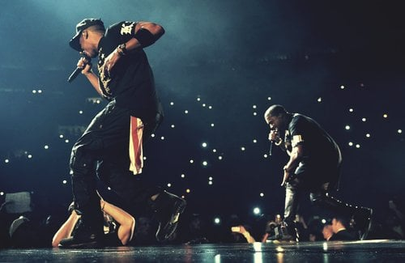
Types of Music
rap

Slide 34
Types of TV. Programs
Soap opera: a continuing program, which follows the lives of a group of people; the stories are often romantic, exciting, dramatic and hard to believe.

Slide 35
Types of TV. Programs
Sitcom: an amusing television drama series about a set of characters. Sitcom is an abbreviation for “situation comedy”.

Slide 36
Types of TV. Programs
Drama: 1. a play for the theater, television, radio, etc. 2. plays considered as a form of literature

Slide 37
Types of TV. Programs
Talk show: a radio or television program in which usually well-known people talk about something or are interviewed.

Slide 38
Types of TV. Programs
Reality show: a television show in which members of the public or celebrities are filmed living their everyday lives or undertaking specific challenges.

Slide 39
Types of TV. Programs
Documentary: a film or television or a radio program that gives detailed information about a particular subject

Slide 40
Types of TV. Programs
Variety show: a show, as on television, made up of many different kinds of acts, as comic skits, songs, dances, etc.

Slide 41
Exercises
1. Reading about movies 2. Listening about movies and TV. programs

Slide 42
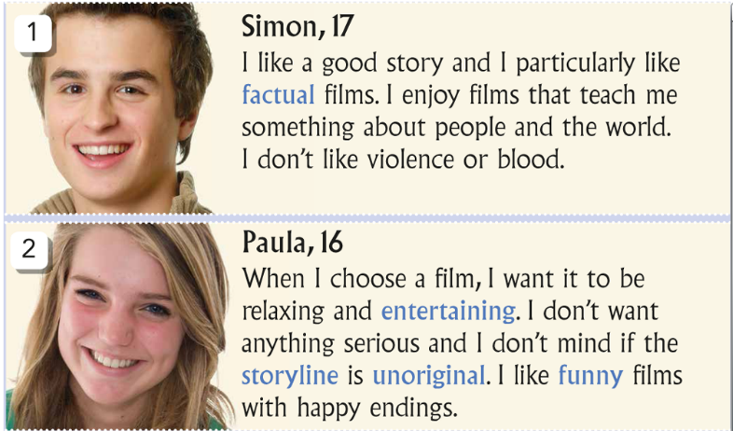
Reading about movies
Read about the types of films that five people like. What type of film is good for each person?

Slide 43
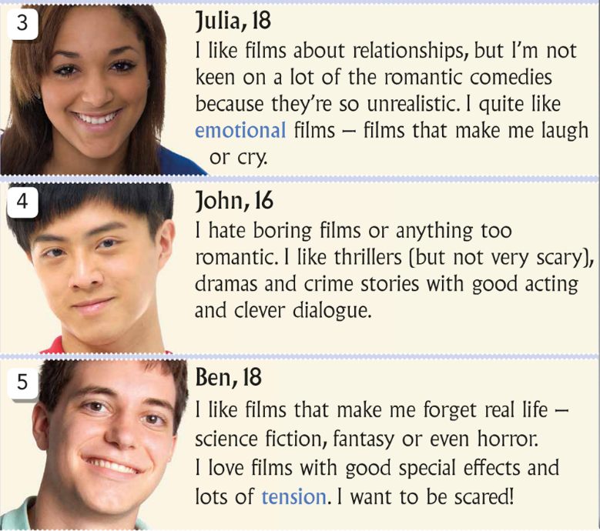
Reading about movies
Read about the types of films that five people like. What type of film is good for each person?

Slide 44
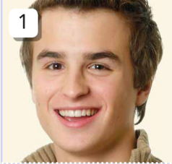
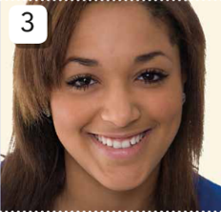
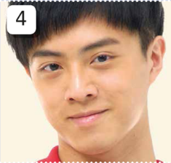
Reading about movies
Name | Favorite Film
Simon
Paula
Julia
John
Ben

Slide 45
Talking about movies and TV. programs
Listen to each person and then complete the chart.
 | Like/Be Fond Of | Dislike/Can’t Stand
Olivia
Ben
Mary
Josh

Slide 46
Talking about movies and TV. programs
Answer the questions correctly
1. Why doesn’t Olivia like watching the horror movies? - 2. Why doesn’t Ben like watching the news? - 3. Why does Ben like watching comedy? - 4. Does May like the reality show? - 5. Who is the movie lover? -

Slide 47
https://quizizz.com/join
Playing a game on Quizziz

Slide 48
https://b.socrative.com/login/student
Having the test on Socrative

